Slide 1
Team Members
Aryan Sovit – 2411021240074
Yashwanth Chandawat - 2411021240005
Muhammed Faiz C K - 2411021240042
IoT-Driven AI Solar Power Prediction System
Smart Grid Stability, Hyper-Local Telemetry, and Deep Learning Forecasting for India

Slide 2


The Real-World Problem: Grid Instability
•
Intermittent Generation: Solar generation swings heavily due to sudden cloud shadows, monsoons, and ambient weather changes.
•
Blind Weather Forecasting: Standard meteorological forecasts are macro-level and miss micro-climate variances at localized solar plants.
•
Grid Balancing Failures: Mismatches between predicted supply and actual demand cause dangerous frequency drops and blackouts.
•
Economic Strain: Grid operators are forced to keep expensive, highly polluting fossil-fuel backup peaking plants spinning.

Slide 3

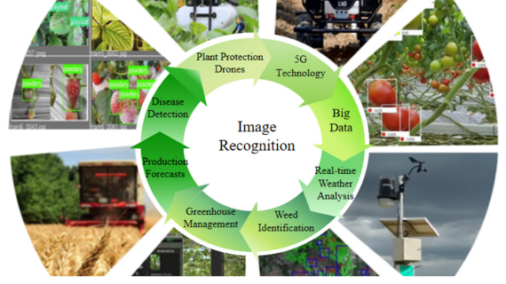
The Solution: Real-Time IoT Telemetry + AI
•
Hyper-Local Edge Sensing: Deploying physical IoT nodes directly at the solar farm site to capture true live environmental conditions.
•
Continuous Data Stream: Hardware pushes live irradiance, temperature, and electrical output telemetry straight to a centralized database.
•
Deep Learning Forecasting: Feeding real-time IoT sequences into trained LSTM (Long Short-Term Memory) networks to predict yields hours ahead.

Slide 4





Integrated IoT Hardware Architecture
ESP32 Microcontroller
Irradiance Sensor
Thermal & Current Sensors
Acts as the local edge device, reading sensor telemetry and transmitting data wirelessly via Wi-Fi/MQTT.
Measures precise sunlight intensity hitting the panel surface to track immediate power generation potential.
Tracks panel surface temperature (DS18B20) and actual DC power output (INA219) for ground-truth validation.

Slide 5



End-to-End IoT-to-AI Data Pipeline
1. Edge Collection
2. Data Processing
3. AI Prediction
ESP32 gathers live sensor streams every minute and pushes payloads to a local MySQL server.
Python script pulls database records, filters out night hours, and scales historical sequence windows.
Trained LSTM network computes rolling solar forecasts and logs outputs for visualization.

Slide 6

Model Evaluation Metrics
•
Root Mean Squared Error (RMSE): Heavily penalizes large forecasting errors, which is vital for preventing major grid imbalances.
•
Mean Absolute Error (MAE): Measures average magnitude of absolute prediction errors across daylight hours.
•
IoT vs. Weather API: Proving that local IoT telemetry drastically reduces error rates compared to macro-level public APIs.

Slide 7
Software Output: Power BI Control Dashboard
•
Operational Control Room: Connecting model predictions directly into Power BI to create an interactive decision cockpit.
•
Visual Overlays: Side-by-side time charts showing live IoT *Actual Generation* versus *AI Predicted Generation*.
•
Proactive Alerting: Visual triggers notifying operators of sudden weather shifts or panel efficiency drops.

Slide 8



Delivered Business & Engineering Value
Grid Resilience
Cost Reduction
Carbon Efficiency
Provides early warning windows to spin up energy storage or backup reserves proactively before drops occur.
Minimizes expensive peak-load fossil backup generation and optimizes plant maintenance loops.
Maximizes clean energy integration into the transmission network, directly lowering overall emissions.

Slide 9

Project Implementation Roadmap
Phase 1: Hardware & Data
Phase 2: AI & Dashboard
• Program ESP32 microcontroller.
• Wire pyranometer & temperature sensors.
• Establish local MySQL database.
• Collect baseline training logs.
• Train and tune LSTM network.
• Validate performance via RMSE/MAE.
• Automate pipeline integration.
• Deploy Power BI live control UI.

